Slide 1

Lets take a journey into IWA 19

Slide 2
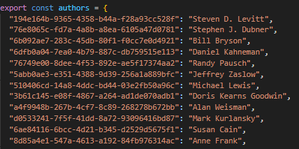
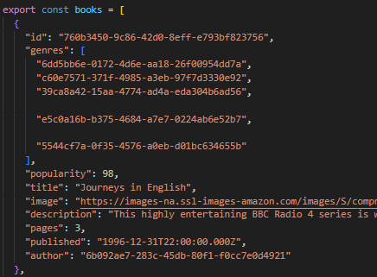
data.js
Within the data.js given , the books were already organised in accordance to their author, genre and then for each group , further sub-organisation sections being the description, ID –tag, popularity, title, author , pages(length), the image and when it was published with the export function already being assigned.

Slide 3

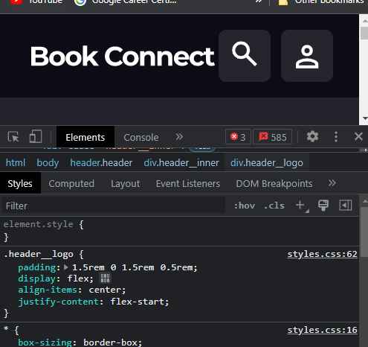
HTML & CSS
The HTML and CSS were found to be fine according to the project brief , however I needed to do an inspection in the developer tools to identify which element was which .

Slide 4
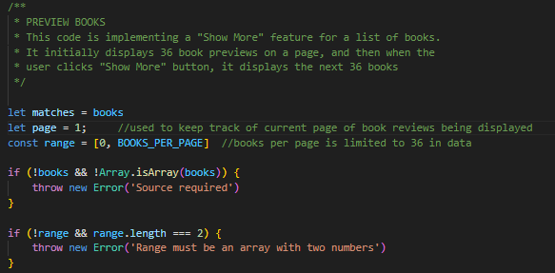
Organisation
By declaring matches = books**
Create page = 1 so that we can keep track of current page
And limited the amount of books per page to 36, we can ensure that it caps to 36 books per page max.
If the books and Array of books in data.js are not found, it will throw error “source required”

Slide 5
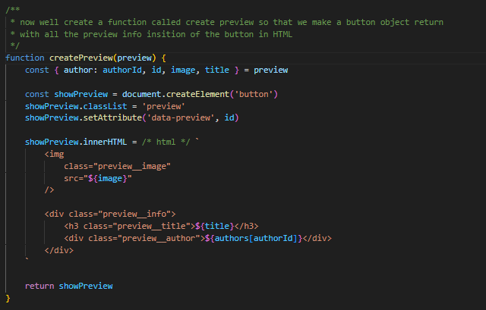
Creating the preview object with a return value:
within the createPreview function , we’ll create a variable containing the author, ID,authorID, image and title of each book in now declared preview.
There after, we’ll create a button in the HTML assigned just to show the information as stated above.
Then reassign the HTML button to display the relevant information by creating a new image element and div in the HTML using JAVASCRIPT
Lastly the function will return the new declared variable in a button in HTML using the return que.

Slide 6
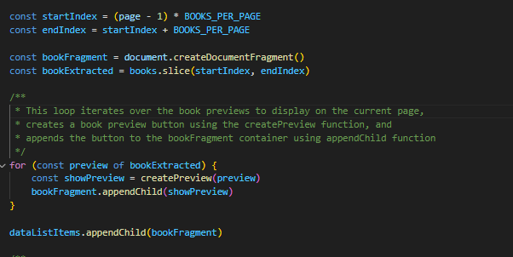
Creating a start index and end index
Because we’ve imported the books per page , and its value is at 36, set a basic start page to display that amount
And then create a document fragment object to store data in the console.
Use the slice function to add all the browsed upon in the array until you get the end of the assortment of books.
append child (book fragment) to the HTML to show the preview

Slide 7
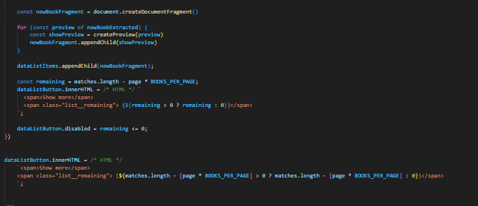
Disabling the show more button:
Now we create a remaining variable for the books left and follow it up with a show more button in the HTML and then we disable the button if there are no more books to view.

Slide 8
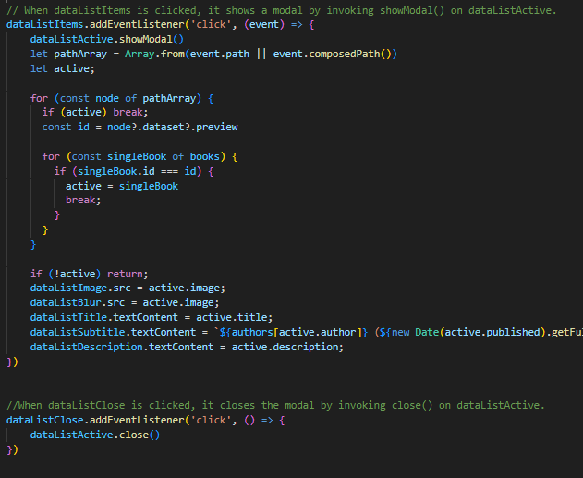
The showmodal function is used to highlight the clicked book in its preview, when we click on the close button it is not highlighted anymore

Slide 9
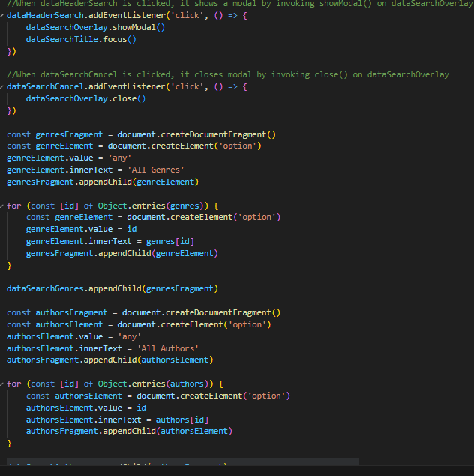
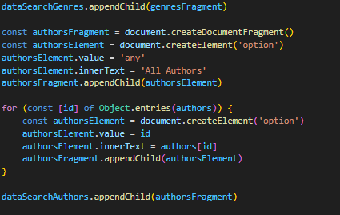
Genres and Authors
GENRES AND AUTHORS
This code creates a document fragment for each 'genres' and 'authors'.
It sets the value of the option to "any" and the inner text to "All Genres" and "All Authors"
respectively. It then loops through an object and creates an option element for each entry,
setting the value to the entry's key and the inner text to its value.
These option elements are added to the fragment, and the fragment is then appended to a dataSearchGenres element and dataSearchAuthors element.

Slide 10
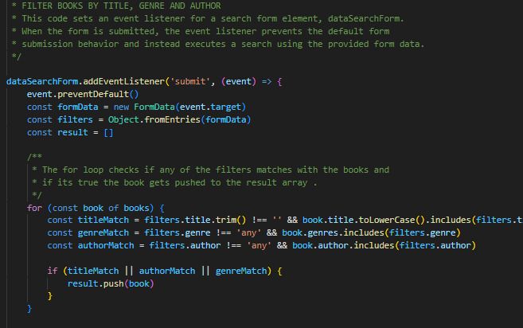

Filtering

Slide 11
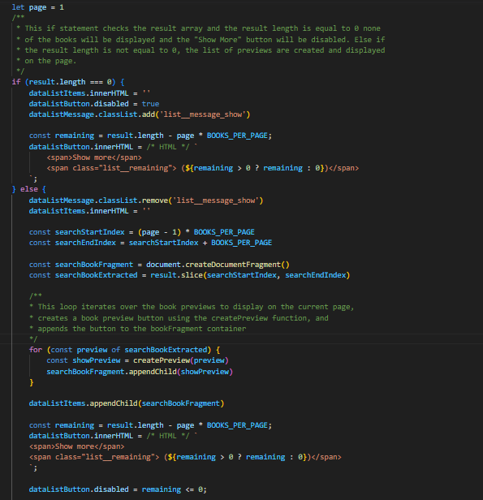

Slide 12
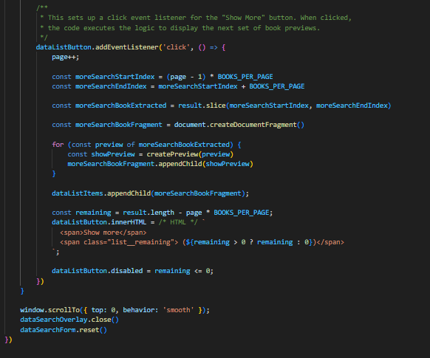

Slide 13
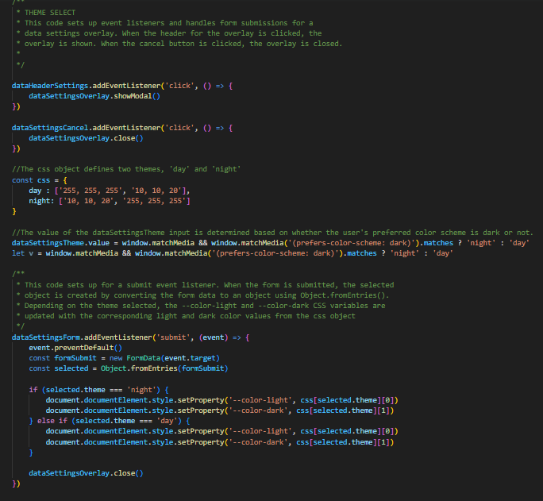

Slide 14

In conclusion ,yes . I did use a little bit of AI to help me where I could not help myself.

